Slide 1

2019 Gender and Veteran Demographics
Findings from 2019 Annual Averages, Current Population Survey
Dr. Nancy A. Glowacki – glowacki.nancy.a@dol.gov

Slide 2

Veterans are 7.5% of the overall population
1 in 13 adults is a veteran

Slide 3
There are nearly 2 million women veterans (1,884,000)

Slide 4

Women veterans are 10% of the overall veteran population
1 in 10 veterans is a woman

Slide 5
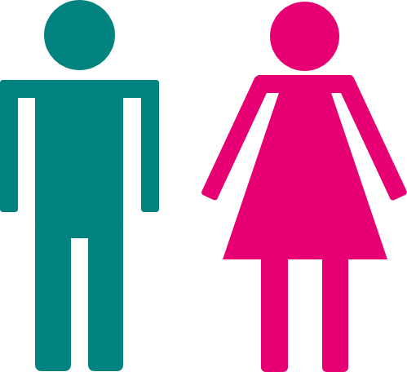
Women are 52% of the general population
1 in 2 adults is a woman

Slide 6

Male veterans are 14% of the overall male population
1 in 7 men is a veteran

Slide 7
Women veterans are 1.5% of the overall women population

Slide 8
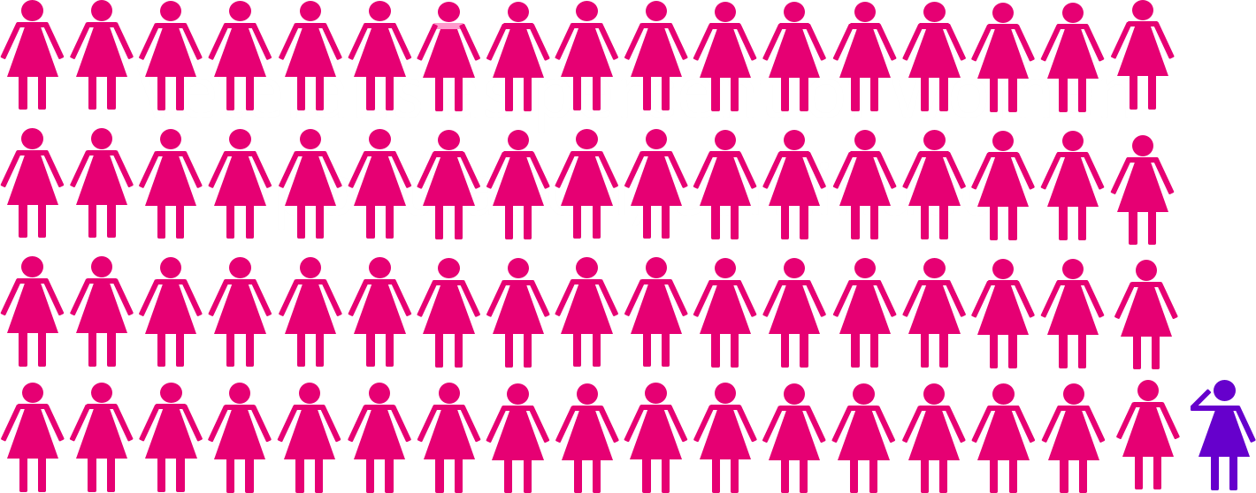
1 in 69 women is a veteran
, continued

Slide 9
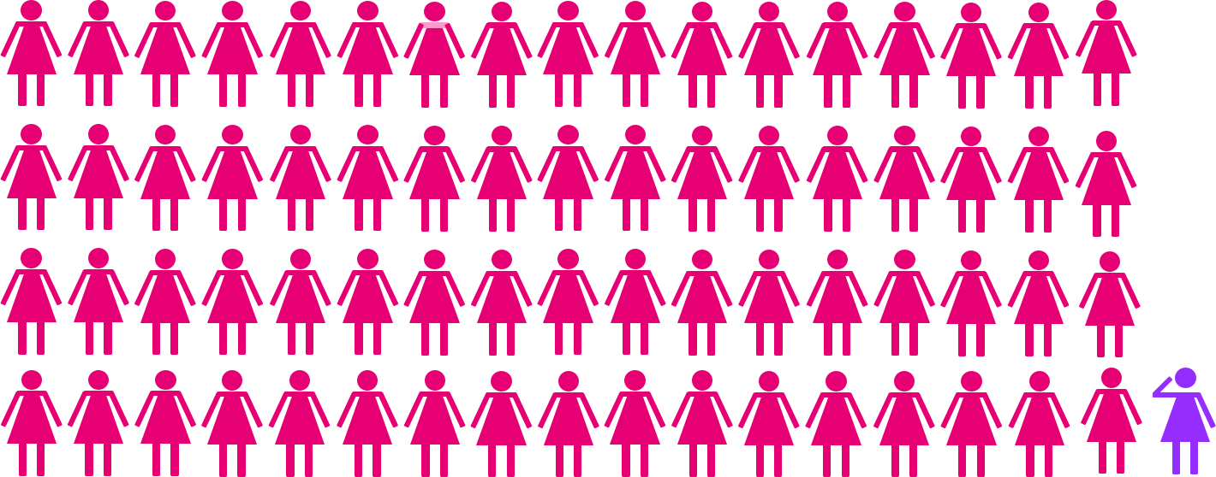
Individual women veterans are still being forgotten

Slide 10
“Have you ever served in the military?”
Ask each and every person!

Slide 11
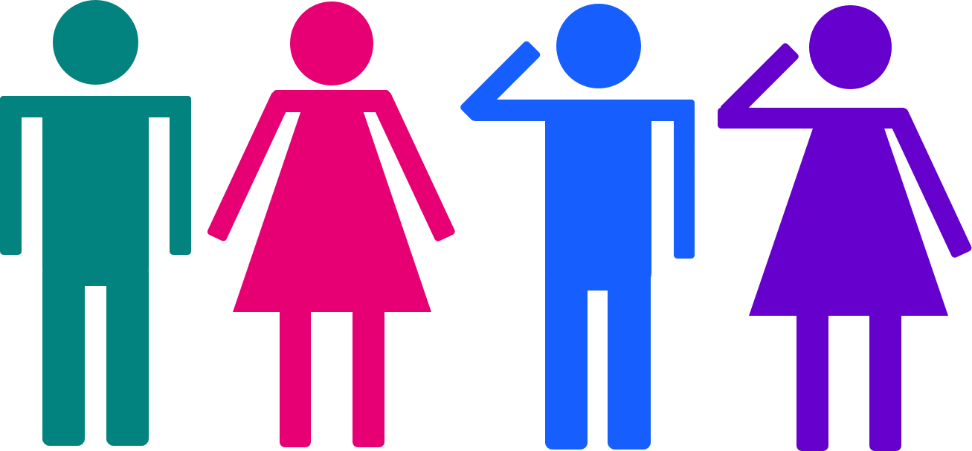
What if we combine men and women and veterans and nonveterans?

Slide 12
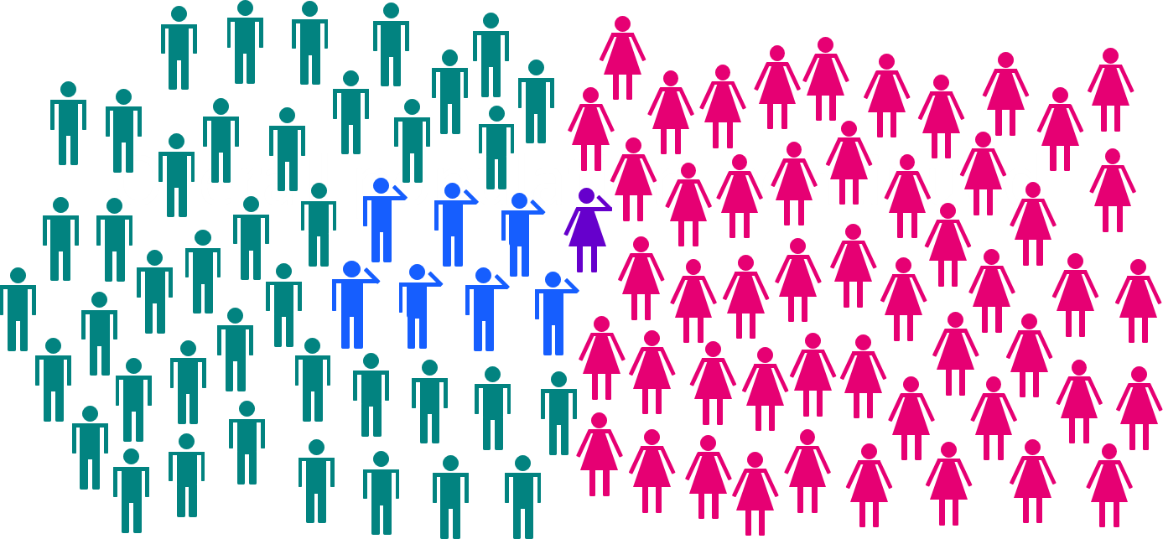
Of 100 adults in the overall population:
7 are male veterans
41 are male nonveterans
1 is a woman veteran
51 are women nonveterans

Slide 13
Under 35 Years Old…

Slide 14
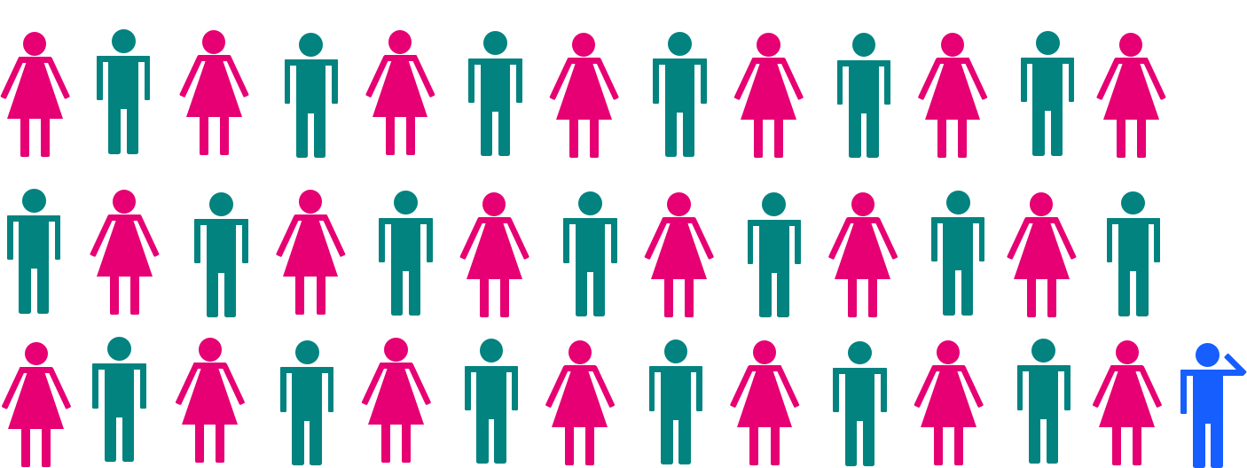
Veterans are 2.5% of the overall under 35 population
1 in 40 adults under 35 is a veteran

Slide 15

Women are 20% of the overall under 35 veteran population
1 in 5 veterans under 35 is a woman

Slide 16

Women are 50% of the general under 35 population
1 in 2 adults is a woman

Slide 17
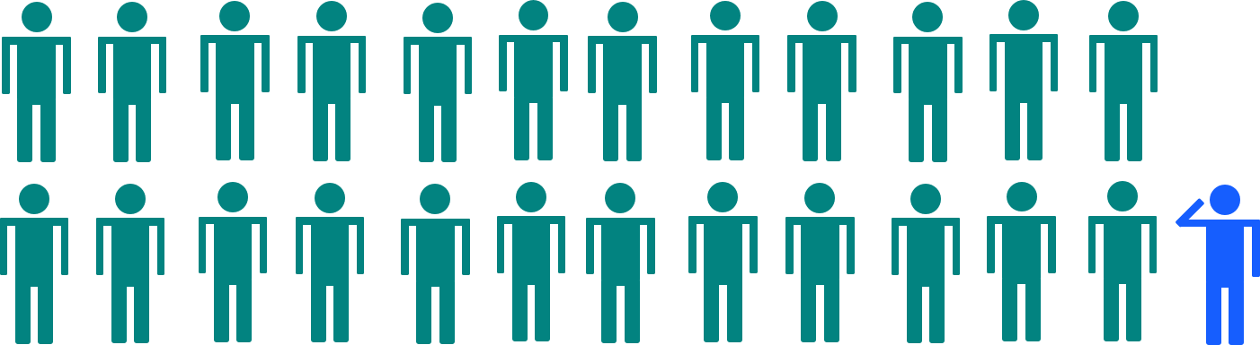
Male veterans are 4% of the under 35 male population
1 in 25 men under 35 is a veteran

Slide 18
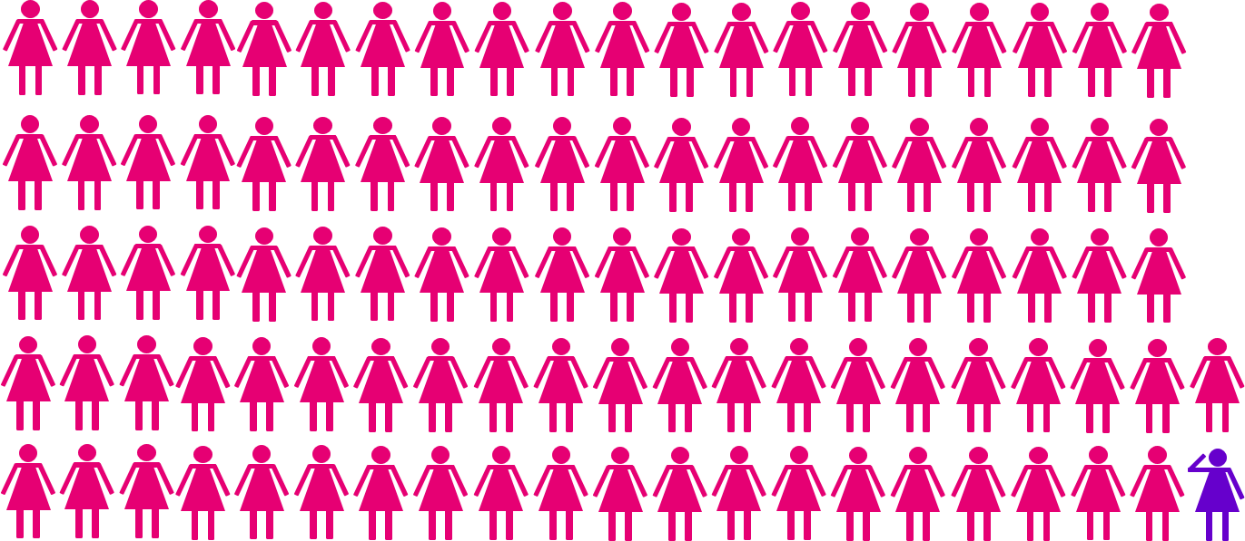
Veterans are 1% of the under 35 women population
1 in 102 women under 35 is a veteran

Slide 19
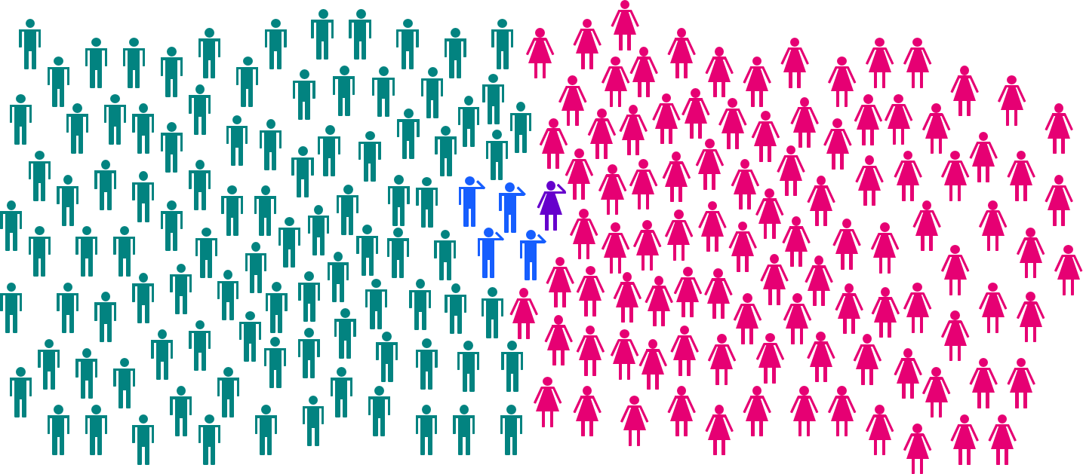
Of 200 adults under 35 in the overall population:
4 are male veterans
96 are male nonveterans
1 is a woman veteran
99 are women nonveterans

Slide 20
Era of Service,
Race and Ethnicity, and Age

Slide 21
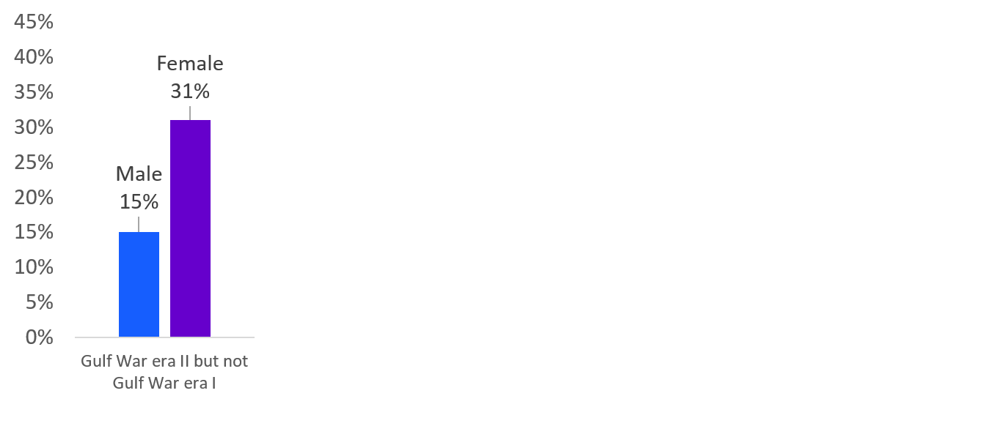
Women veterans are: twice as likely as male veterans to have served in Gulf War II only,

Slide 22
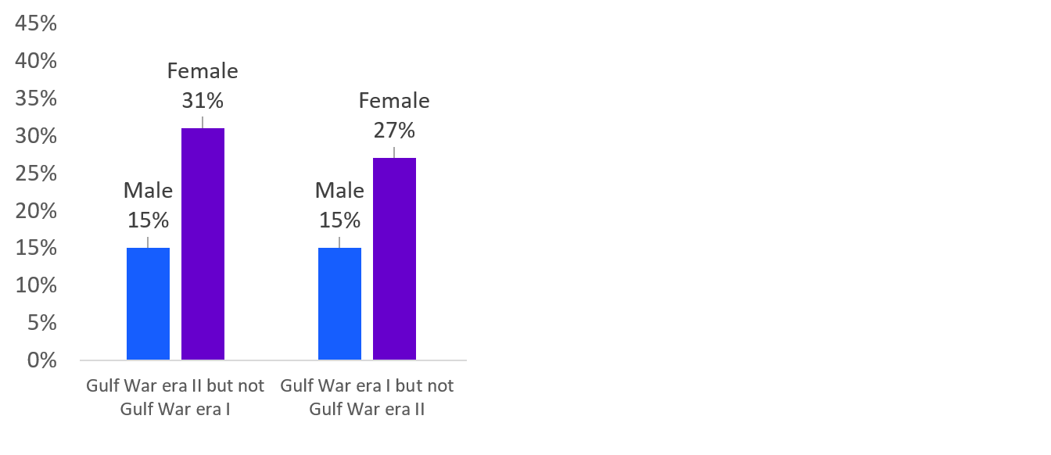
Women veterans are: twice as likely as male veterans to have served in Gulf War II only, more likely than male veterans to have served in Gulf War I only,

Slide 23
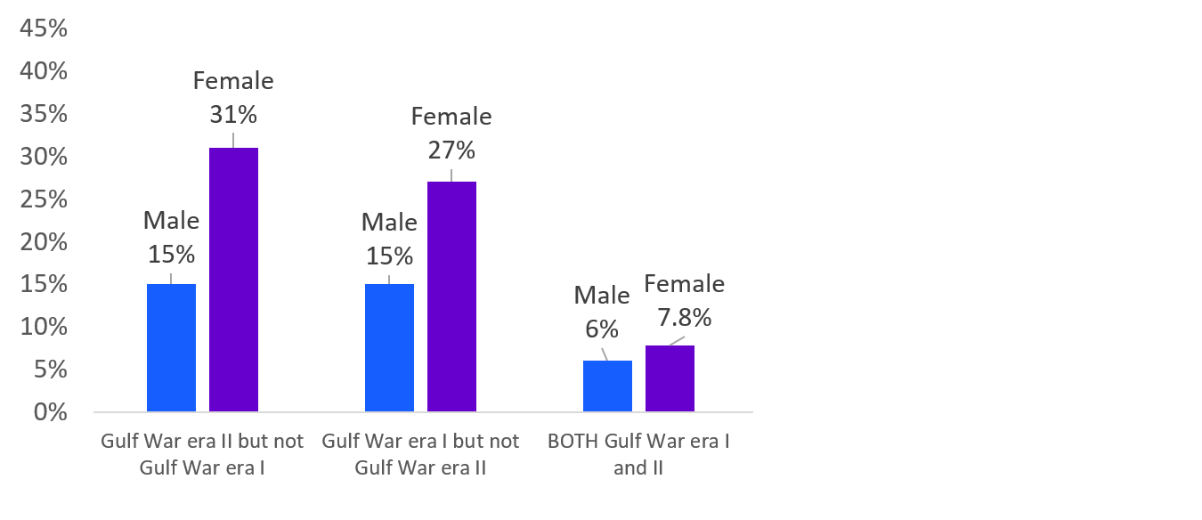
Women veterans are: twice as likely as male veterans to have served in Gulf War II only, more likely than male veterans to have served in Gulf War I only, and are more likely to have served in both Gulf War Eras

Slide 24
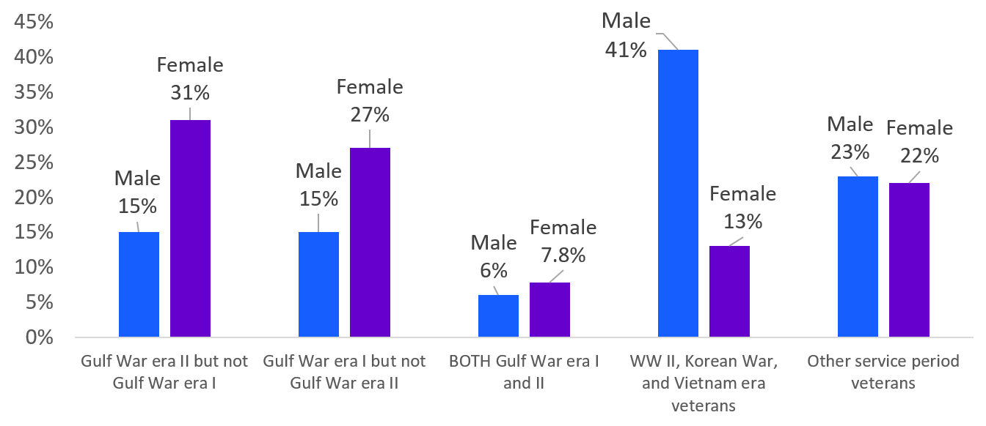
Women veterans are: twice as likely as male veterans to have served in Gulf War II only, more likely than male veterans to have served in Gulf War I only, and are almost twice as likely to have served in both Gulf War Eras
Male veterans are three times as likely as women veterans
to have served in WW II, Korean War, Vietnam Eras

Slide 25
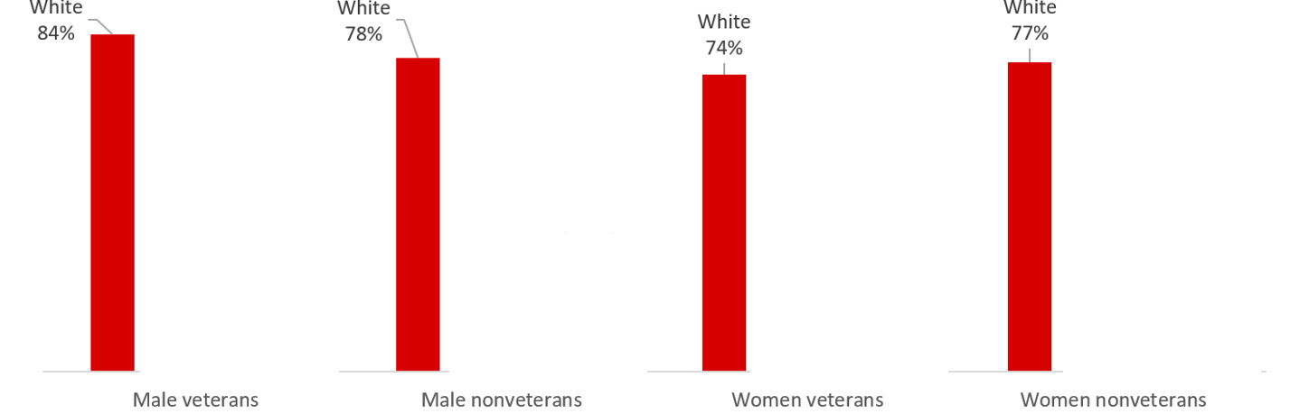
The majority of veterans are white; however women veterans are less likely than male veterans to be white

Slide 26
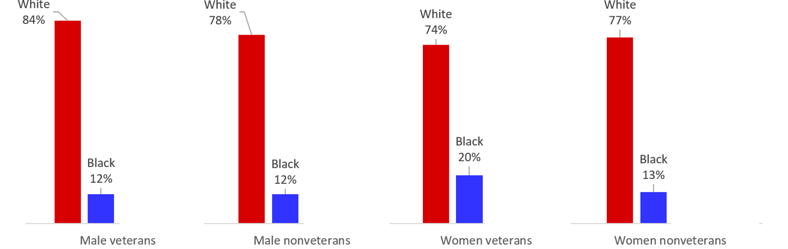
The majority of veterans are white; however women veterans are less likely than male veterans to be white
Women veterans are more likely than male veterans or nonveterans of either gender to be Black or African American

Slide 27
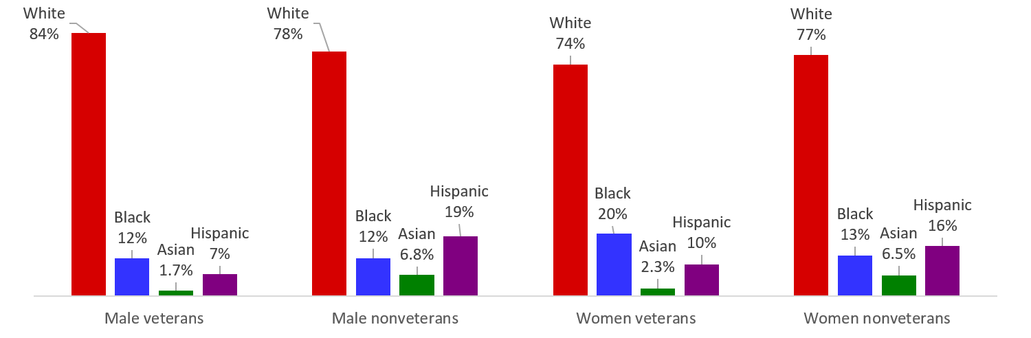
The majority of veterans are white; however women veterans are less likely than male veterans to be white
Women veterans are almost twice as likely as male veterans or nonveterans of either gender to be Black or African American
Veterans are less likely than nonveterans to be Asian or Hispanic/Latino

Slide 28

The median age of women veterans is 14 years younger than the median age of male veterans.
Median age
Male veterans:
65 years old
Male nonveterans:
44 years old
Women veterans:
51 years old
Women nonveterans:
48 years old

Slide 29
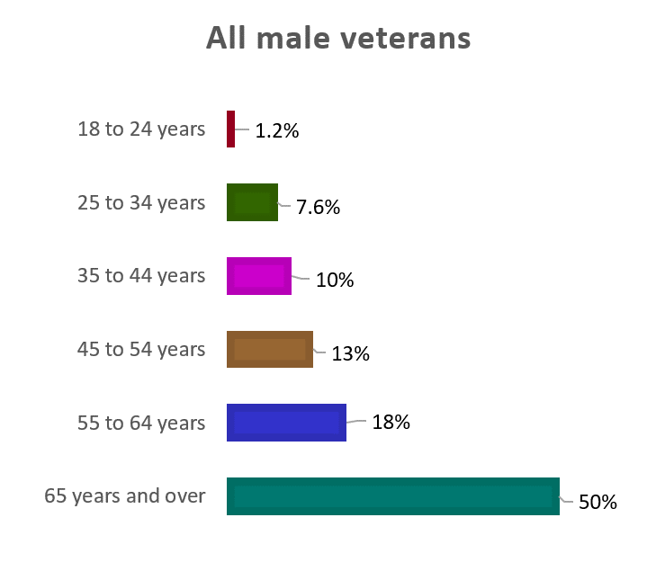
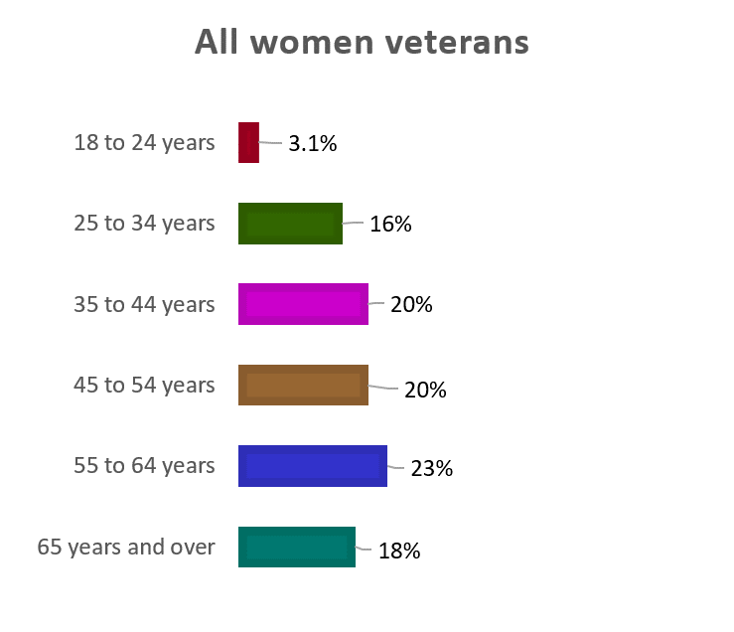
Women veterans are more likely to be of working age than male veterans
Half of all male veterans are 65 years old and over,
compared to 18% of all women veterans

Slide 30
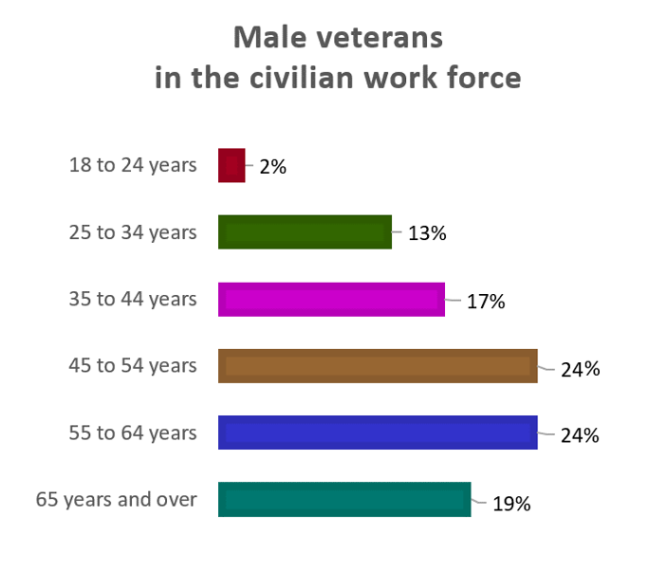
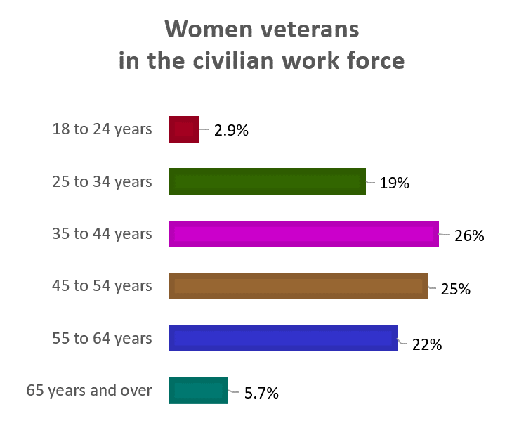
Women veterans in the work force are more likely to be of working age
19% of male veterans in the workforce are 65 years
old and over, compared to 5.7% of women veterans

Slide 31
The civilian labor force includes both people who are employed and people who are not currently working, but who are available for work and actively seeking work (unemployed)

Slide 32
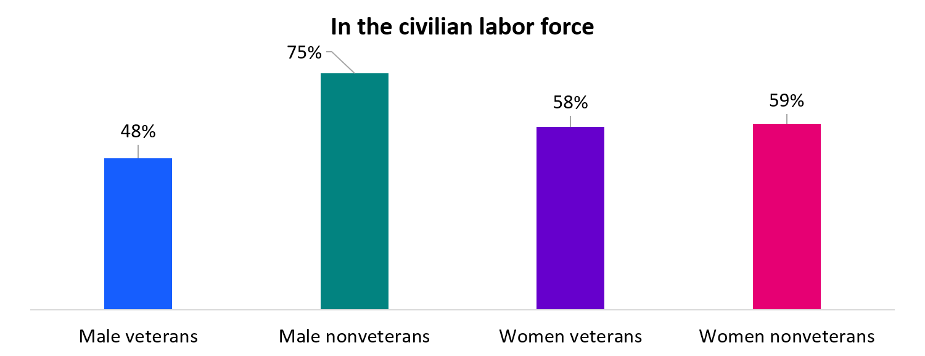
Women veterans are more likely than male veterans to be in the labor force

Slide 33

Civilian Labor Force

Slide 34

Within the civilian labor force, the median age of women veterans is 6 years younger than the median age of male veterans
Median age
Male veterans:
52 years old
Male nonveterans:
41 years old
Women veterans:
46 years old
Women nonveterans:
42 years old

Slide 35
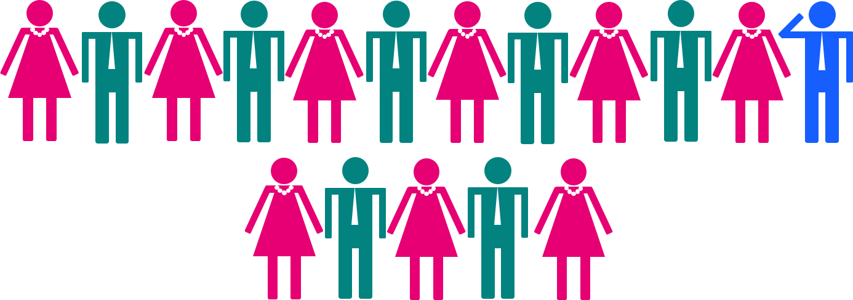
Veterans are 5.7% of the civilian labor force
1 in 17 adults in the civilian labor force is a veteran

Slide 36

Women are 47% of the labor force
1 in 2 adults in the labor force is a woman

Slide 37

Women veterans are 12% of veterans within the civilian labor force
1 in 8 veterans in the civilian labor force is a woman

Slide 38
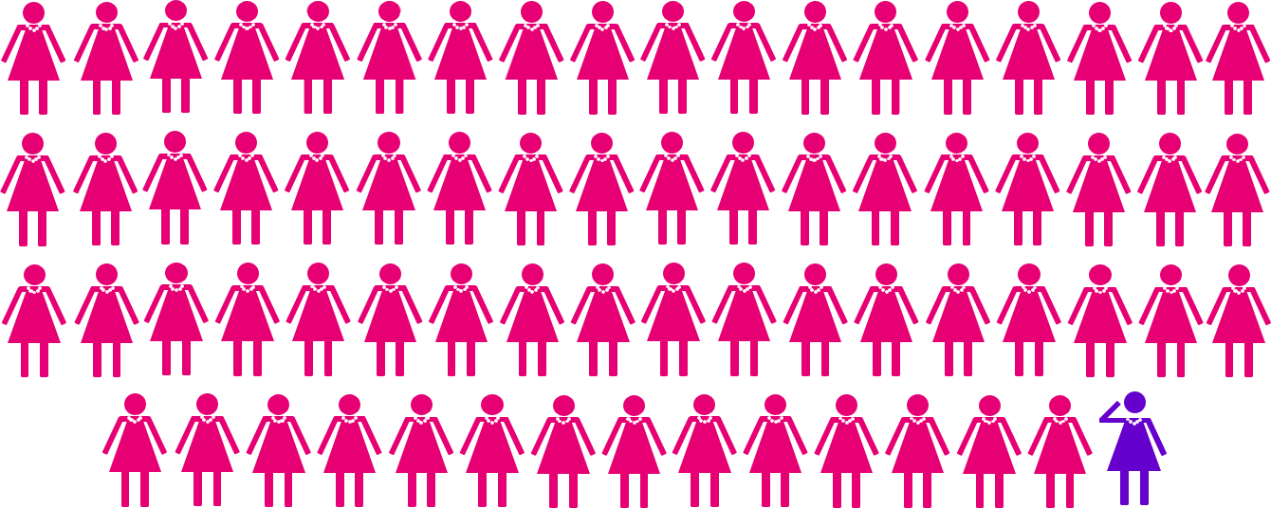
Women veterans are
1.5% of women in the civilian labor force
1 in 69 women in the civilian labor force is a veteran

Slide 39

Male veterans are
9.5% of males in the civilian labor force
1 in 10 men in the civilian labor force is a veteran

Slide 40
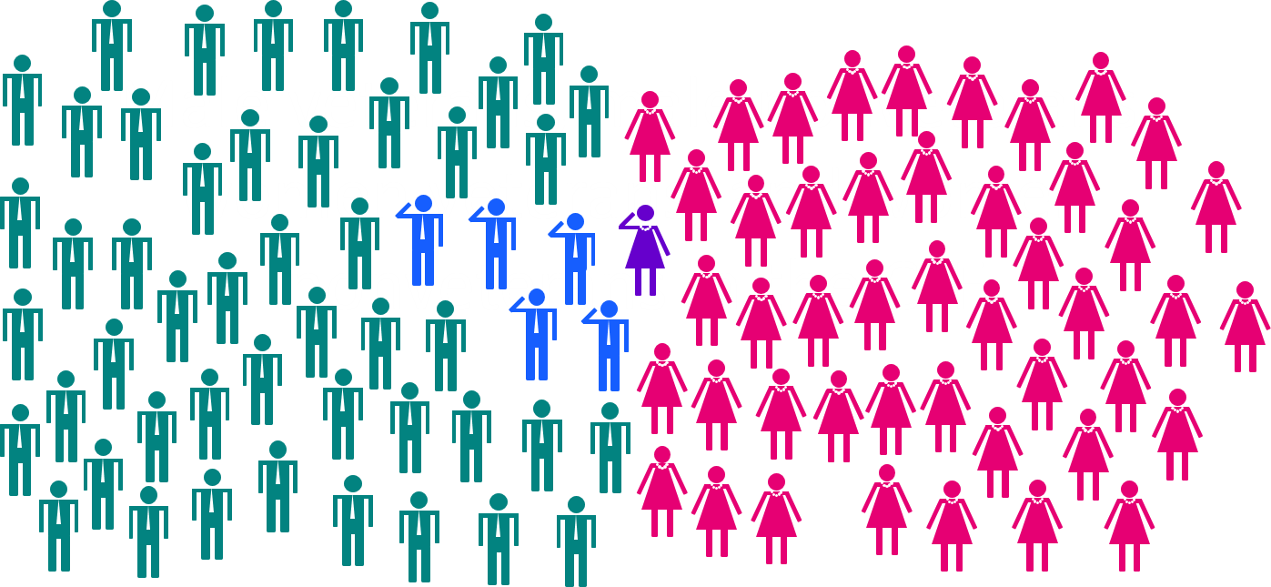
Of 100 adults in the civilian labor force:
5 are male veterans
48 are male nonveterans
1 is a woman veteran
46 are women nonveterans

Slide 41
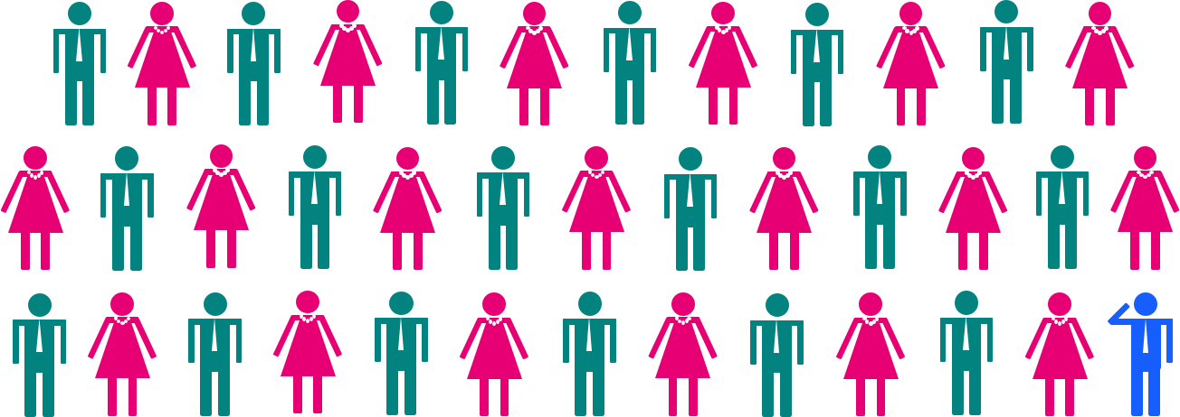
Veterans are 2.7% of the under 35 civilian labor force
1 in 38 adults under 35 in the civilian labor force is a veteran

Slide 42

Women veterans are 16% of the veterans under 35 within the civilian labor force
1 in 6 veterans under 35 in the civilian labor force is a woman

Slide 43
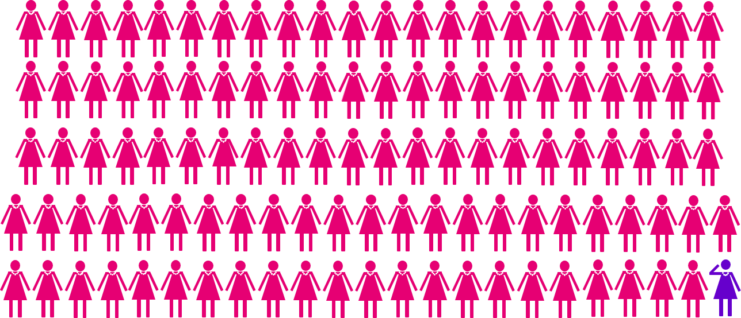
Women veterans are .9% of women under 35 in the civilian labor force
1 in 112 women under 35 in the labor force is a veteran

Slide 44

Male veterans are 4.2% of males under 35 in the civilian labor force
1 in 24 men under 35 in the labor force is a veteran

Slide 45
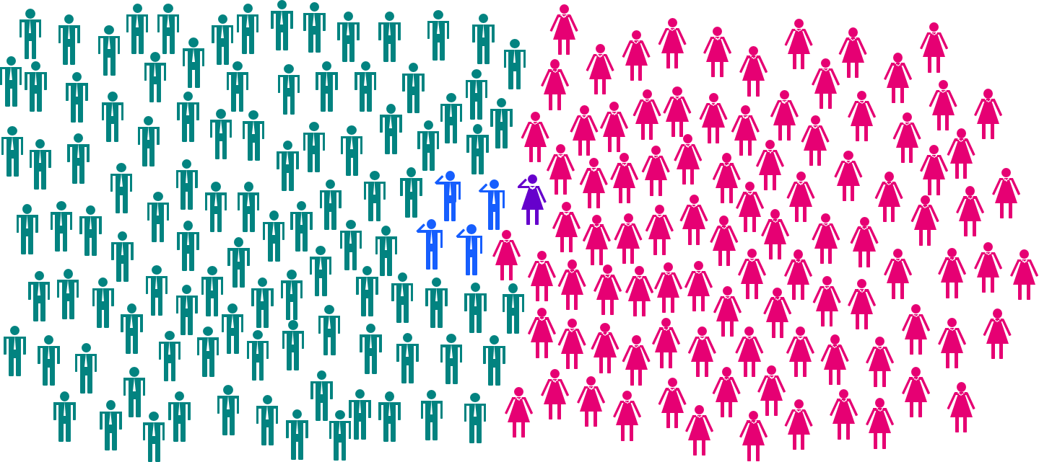
Of 200 adults under 35 in the civilian labor force:
4 are male veterans
101 are male nonveterans
1 is a woman veteran
94 are women nonveterans

Slide 46
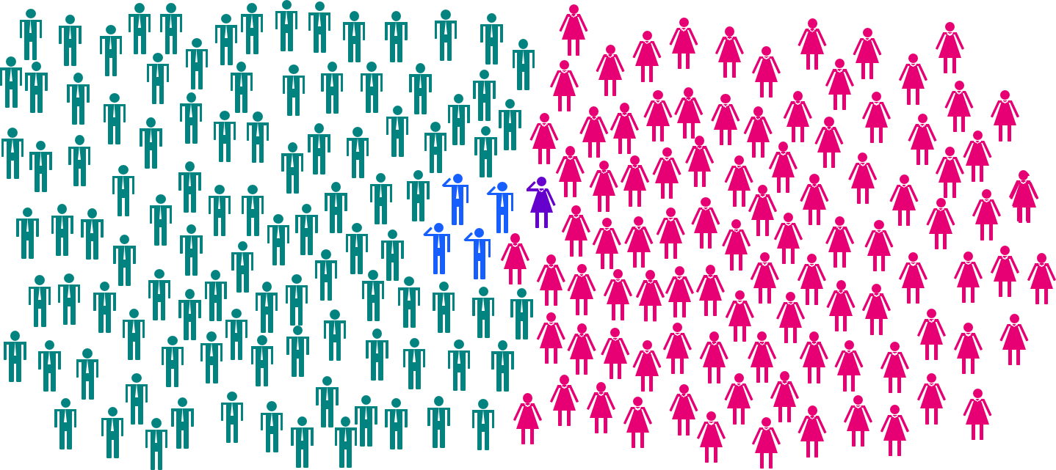
“Have you ever served in the military?” must be asked every time!

Slide 47
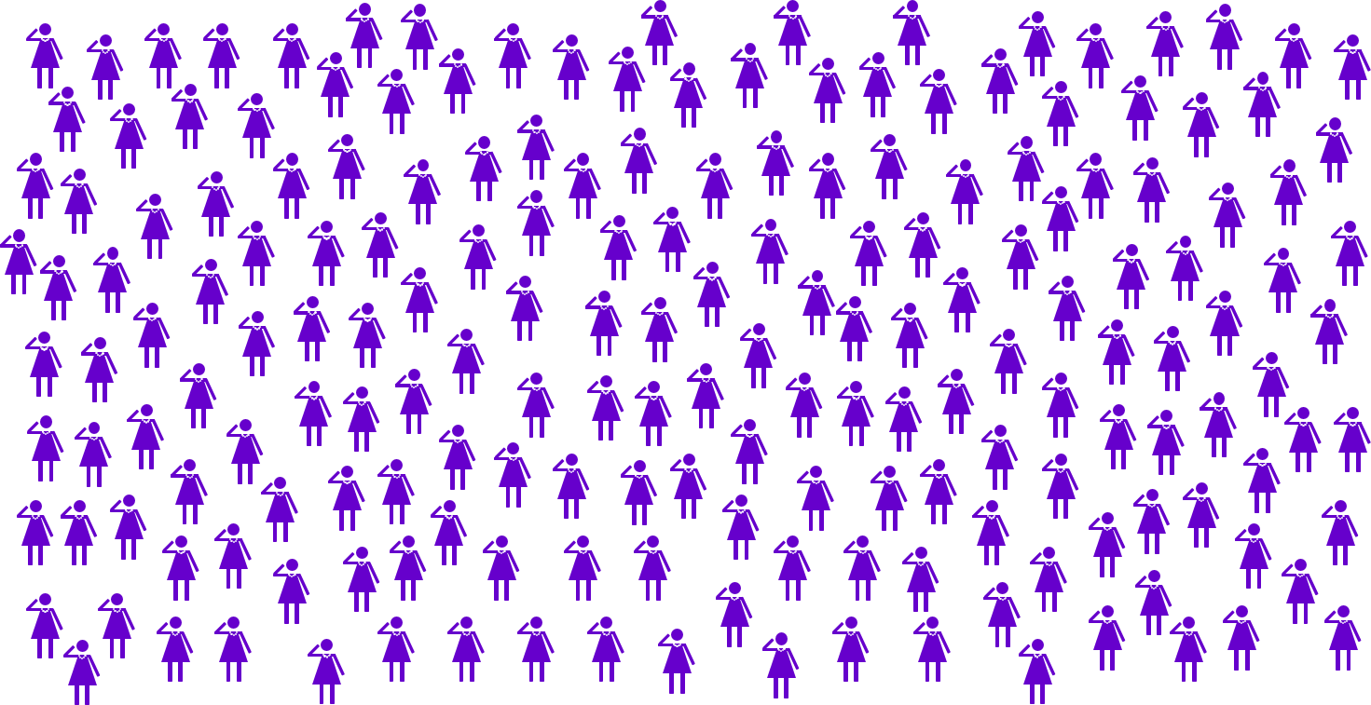
“We are Veterans!!!”

Slide 48

Closing slide
Dr. Nancy A. Glowacki – glowacki.nancy.a@dol.gov

