Slide 1
We Want to Hear From YOU!
We recommend that you use a phone to connect to the webinar not a computer. Please also be sure to enter the audio pin provided by Go To Webinar.
It will be easier to for you to communicate, and us to listen to, your insights and experiences.
Notes:
Slide Up as Entry Background: Start at approx. 1:45PM EST.

Slide 2
Community of Practice engaging Women Veterans
December 5th, 2019

Slide 3
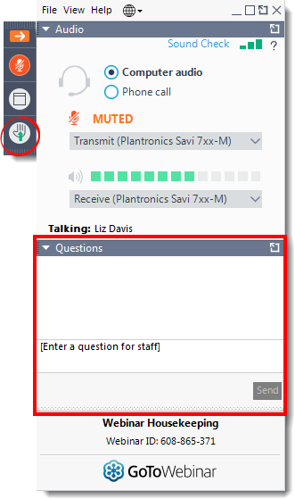
We want to hear from you!
If you have a question, and want to speak, raise your hand we can keep a queue.
If you don’t want to speak, use the question box to respond or ask a question.

Slide 4
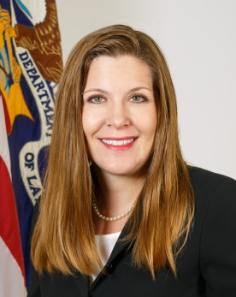
Meet Our Guest Facilitator
Nancy A. Glowacki, DM
Advisor, Women Veterans
Dr. Nancy A. Glowacki serves as an advisor on women veterans for the U.S. Department of Labor (DOL) Veterans’ Employment and Training Service (VETS). In this role she is responsible for continuously monitoring the overlapping considerations of working veterans and working women to ensure that DOL’s employment services are meeting the needs of women veterans. She also serves in an advisory role on the status of women veterans and employment and collaborates with interagency partners to ensure that service providers and other influencers of women veterans know how to access free employment services available to their women veteran clientele.
Prior to coming to VETS, Dr. Glowacki served as a subject matter expert on veterans’ transition issues in employment and special challenges faced by disabled veterans at the Department of Veterans’ Affairs and as an independent consultant and volunteer. She also served as an appointed committee member for the Department of Veterans Affairs’ Advisory Committee for Women Veterans and Advisory Committee on Rehabilitation.
Dr. Glowacki is a veteran of the U.S. Army and served among both the enlisted and officer ranks. Dr. Glowacki’s education includes a Doctorate of Management in Organizational Leadership, a Masters of Business Administration in Human Resource Management, and a Bachelor of Science.

Slide 5
Listening Sessions: Purpose and Process
NVTAC and DOL-VETS wanted to know more about the realities, challenges, and best practices related to serving homeless female veterans.
It was not a training.
These sessions were designed to feature HVRP’s input and expertise.
1 hour long
5 questions
4 optional polls

Slide 6
Initial Observations: 1
Every session expressed a desire for more resources targeted towards Women Veterans and, specifically, options related to emergency housing assistance.
Children and childcare present a significant challenge for grantees.
Know the state and local resources and make a connection with them.
Notes:
For example, women fleeing domestic violence don’t have the luxury to wait for the HUD-VASH voucher process to find housing. They need housing yesterday. One grantee that specifically serves women veterans works with a lot of women fleeing domestic violence with their children. They estimate that about 50-60% of their participants are women with children. It can be particularly difficult to find an immediate, temporary housing location for a woman and her child, and even more so if the child is an adolescent male. Other concerns include oversaturation or regulation of local resources, such as safe houses or shelters.
Every grantee that spoke noted some issue relating to complications and challenges with children. Some shelters will not take in large families, others will not take in families with male children above a certain age, usually around 10. Other areas have limited female-specific shelter resources that may be full. Some shelters are in parts of town that a woman, especially one who has experienced trauma, may not want to go and especially not with a child. Even if the grantee can find housing placement for the woman, that placement often creates a transportation burden especially when considering schools, doctors, and their own employment needs.
Many of the grantees we listened to utilize state and local resources in addition to programs like SSVF, HUD-VASH, GPD, and VHA. One grantee works with a local faith-based organization for mentorship and transportation. Another grantee knows every woman’s shelter in their immediate area has a running list. Yet another grantee regularly contacts their local women’s shelters to try to find and serve women veterans. That grantee has also spent years building relationships with the local school system and its guidance counselors in an effort to serve women veterans with children

Slide 7
Initial Observations: 2
Women Veterans often do not self-identify as such.
Women Veterans may not appear “homeless enough.”
Relate to the individual.
Notes:
Multiple grantees across from across the country have said in some way that women veterans do not, for one or several of many reasons, want to identify as a veteran. Some fear stigma and potential re-traumatization. Others may feel that asking for help as a woman and a veteran would be weak. Others may have had bad experiences with resources prior to HVRP. Others simply do not want the label. That is why that one grantee works with women’s shelters to find women veterans- they may avoid veteran specific resources and select into woman specific resources.
Simply speaking, we’re talking about appearance. Homeless women veterans, especially those with children, will try not to appear homeless. They don’t want to be stigmatized or treated differently. They want to keep their children and wearing raggedy clothes, appearing stereotypically homeless, is a great way to lose custody or visitation rights. And this observation ties into not wanting to self-identify, both as homeless or as a veteran.
All the engagement and trust building strategies that were discussed all involve relating to the person, not just seeing them as a woman veteran or a homeless woman or a veteran, etc. One grantee described it succinctly as “They want empathy, not sympathy.” Many women veterans find it easier to share their stories with other women veterans. But even if an HVRP does not have a women who served on their staff, there are other ways to relate and engage. For example, facilitating a peer to peer group, facilitating a child-friendly movie night, and just providing a safe, comfortable space. At the end of the day, these are people in all their uniqueness that also just happen to be women and happen to have served- just reach out to the person.

Slide 8
Discussion Question 1
How does your service delivery approach change when serving Women Veterans with children?
Notes:
Based on your experiences and what we have discussed so far, please contemplate these questions.

Slide 9
Discussion Question 2
How do you change your engagement strategies to be respectful of both disclosed and potentially undisclosed trauma?

Slide 10
Discussion Question 3
How does a Woman Veteran “not appearing homeless enough,” and potentially having had bad experiences with other services, impact your ability to cultivate trust and engage?

Slide 11
Discussion Question 4
What resources would increase your ability to help women who have served?

Slide 12
Questions? Comments?

Slide 13
Do you have questions for us?
Email:
Cori Di Biase: contact@nvtac.org
Dr. Nancy Glowacki: Glowacki.Nancy.A@dol.gov
Continue the conversation at:
nvtac.org/nvtac-knowledge-network/

